Slide 1
CAR FX

Slide 2
Table of contents
01
02
03
Purpose
Significance
Tech & Tools
04
05
06
Description
Display
Conclusions

Slide 3
Purpose statement
01

Slide 4
In a fast-paced modern world, time is a constraint for many individuals. Many people prefer the exchange of goods and services over an online platform due to this. The world of technology helps digitize the purchasing of goods and saves time and money. It also provides a virtual experience simulating a real environment.

Slide 5
Significance
02

Slide 6
‘Car FX’ being an online platform, can be accessed from anywhere by anyone interested in customizing their cars. It allows the customers to choose their desired customization and also helps them visualize the final product with the help of a 3D model. It makes the whole process more convenient and less time consuming.

Slide 7
Tech & Tools
03

Slide 8



NETBEANS
MSQL
BLENDER
It is an integrated development environment (IDE) for
Java. NetBeans runs on Windows, macOS, Linux and
Solaris.
It is a relational database management system.
Free and Open Source 3D creation suite

Slide 9
Description
04

Slide 10
Our project is an online retail outlet named ‘Car FX’ that allows customers to customize their cars at the click of a button without taking time out of their hectic schedules. It first allows people to create accounts then It displays a catalogue, that provides customization options such as seat covers, dashboard lights, speaker enhancement and dashboard accessories. After choosing the customization, the customer can visualize their final product as well.

Slide 11
Display
05

Slide 12
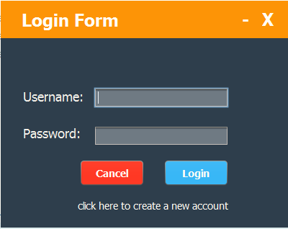
LOG IN / SIGN UP

Slide 13
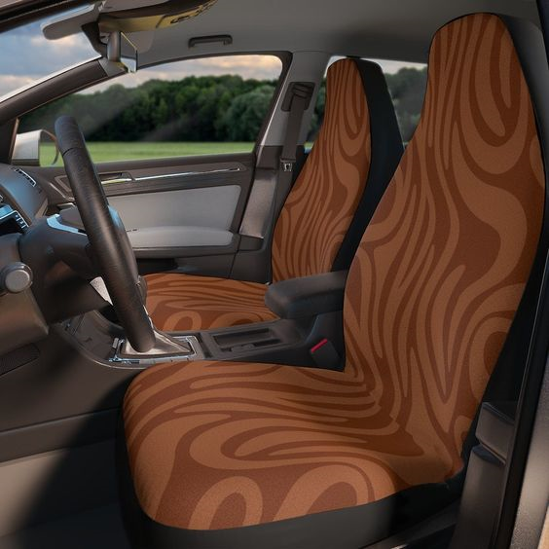
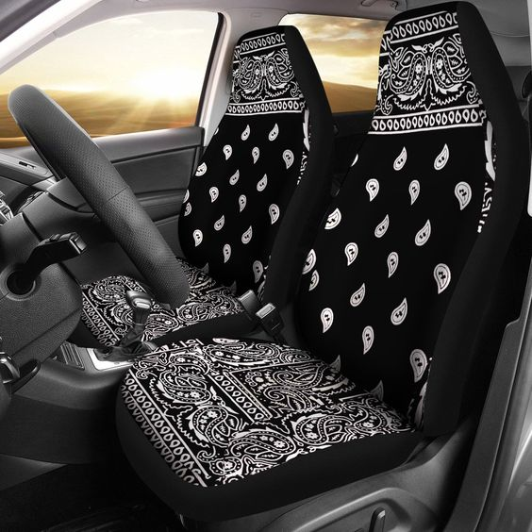
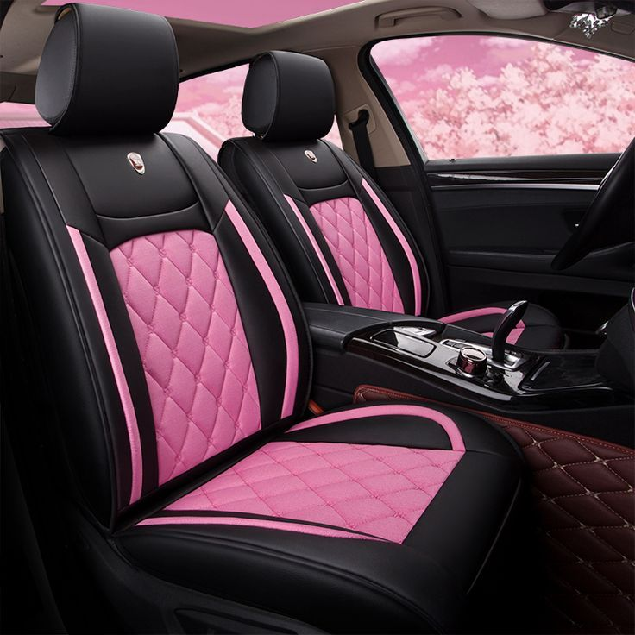
CATALOGUE-Seat Covers

Slide 14
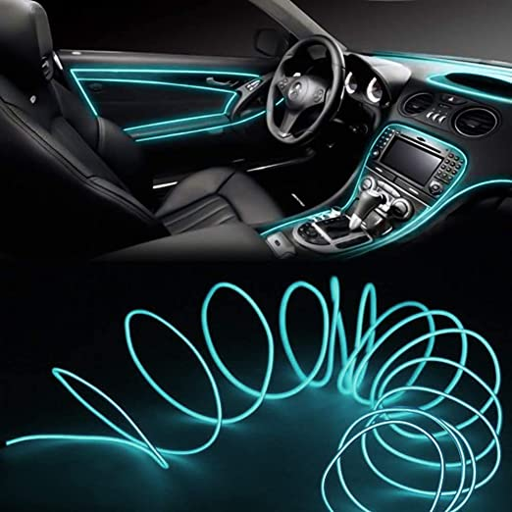
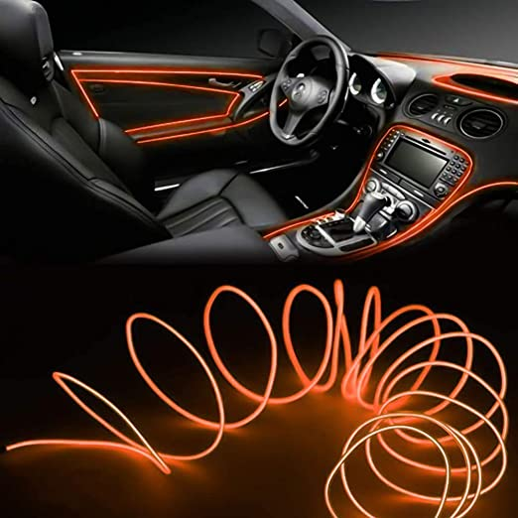
CATALOGUE – Dashboard Lights

Slide 15
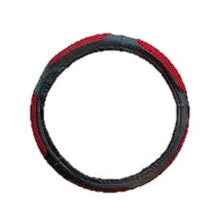
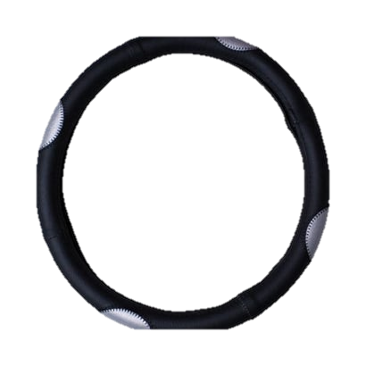

CATALOGUE –Steering Wheel Covers

Slide 16
3D representation of the seat cover design chosen by the customer

Slide 17
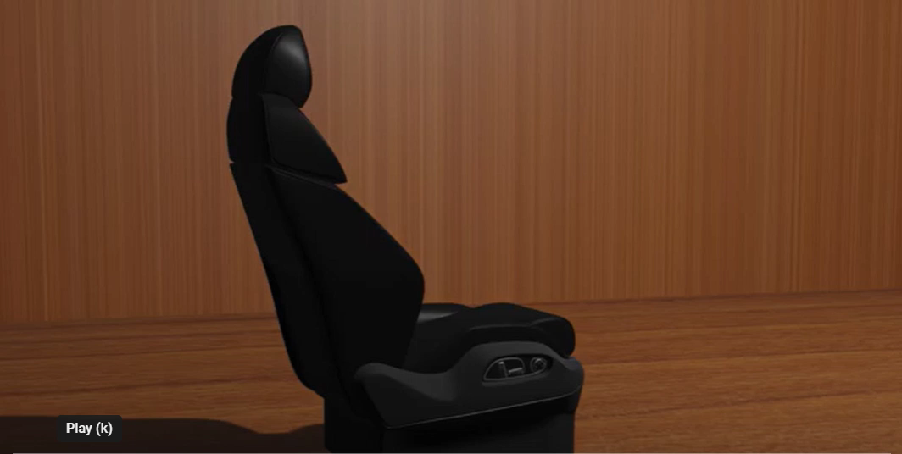
Cyber-Futuristic AI Technology Thesis Defense
Here is where your presentation begins

